Slide 1
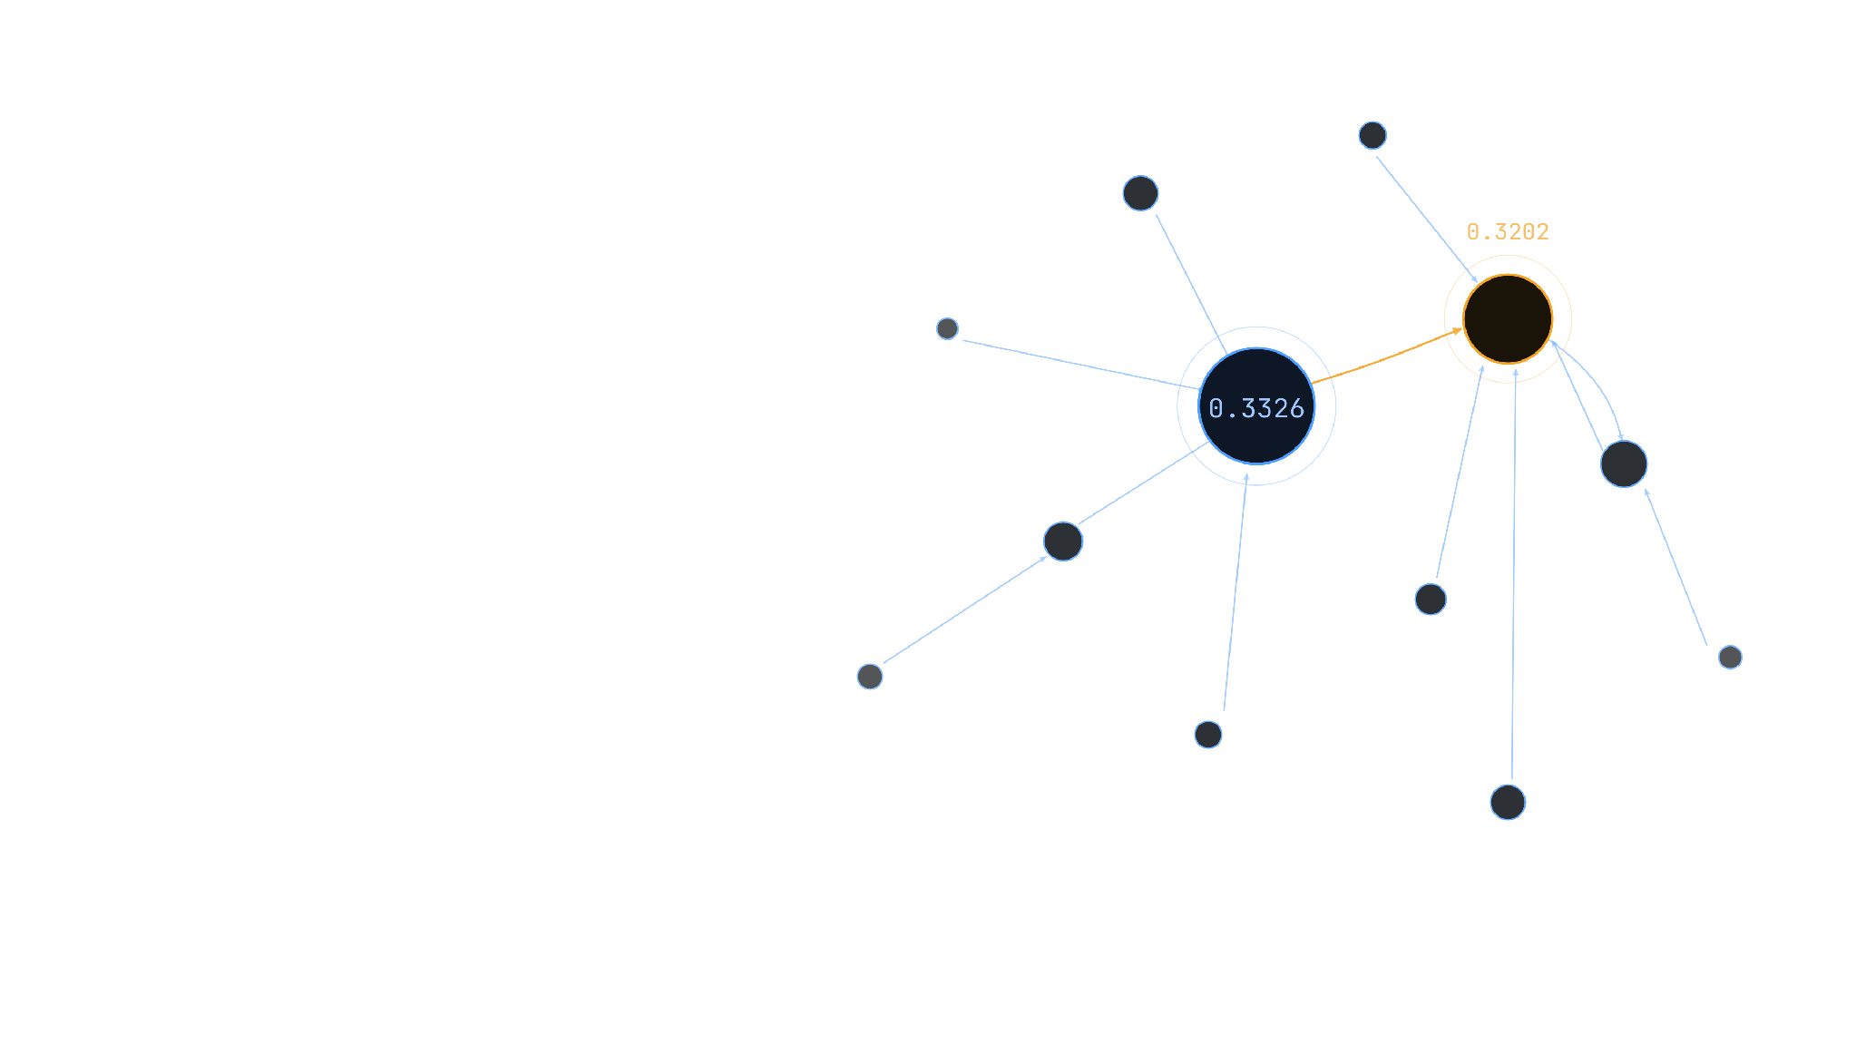
CSS 311 · PARALLEL AND DISTRIBUTED COMPUTING
PageRank Algorithm
From Serial Recurrence to OpenMP Parallel Design
Assignment I · Module I & II
Niranjan R Soorej · 2024BCS0117 · Mohammed Ashar Husain · 2024BCS0137
Notes:
Open by asking the audience: how does a page become important on the web? Don't answer yet — let the graph in the background make the point visually. State the two-part thesis of the talk: first, PageRank turns link structure into a numerical importance score using a recurrence relation; second, that recurrence has independent per-node work inside each iteration, which is what lets us parallelize it with OpenMP. Read the title and subtitle aloud, then name the module and assignment context, then introduce yourselves briefly. Keep this slide under 30 seconds — it's a hook, not content.

Slide 2
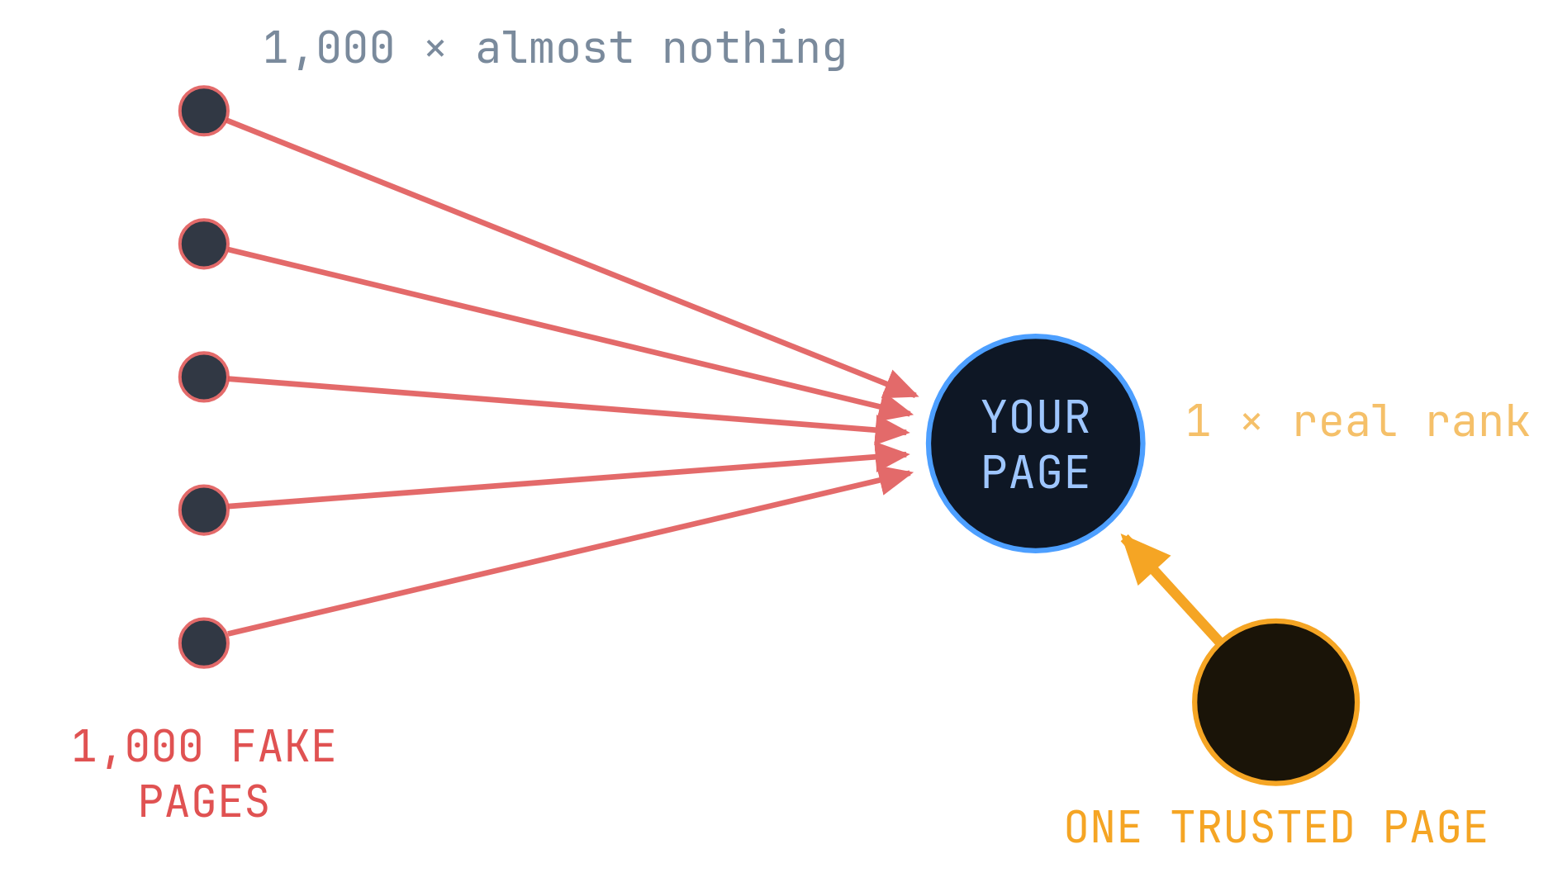
INTRODUCTION · THE ORIGINAL INTUITION
A link is a vote — but not every vote is worth the same
01
A link is a vote for another page.
02
A vote from an important page counts for more.
03
A page splits its importance across its out-links — so voting costs rank.
THE CHEAT
THE FIX
Build a thousand pages of your own and point them all at yourself.
Nobody links to those pages, so they hold almost no rank to give away. A thousand empty votes stay worth almost nothing.
And 15% of the time the surfer ignores links entirely and jumps to a random page — so a closed loop of pages cannot hoard rank either. That 15% is the damping factor d = 0.85 used for the rest of this deck.
Notes:
This slide answers 'why not just count links?' before the technical algorithm shows up. Walk it in order: (1) a link is a vote for another page; (2) but a vote from an important page should count for more than one from an unimportant page — otherwise the metric is trivially gamed; (3) show THE CHEAT — build a thousand throwaway pages and point them all at yourself; (4) show THE FIX — a page can only give away the rank it already has, and a brand-new fake page starts with almost none, so a thousand worthless votes are still worth almost nothing; (5) mention the 15% random jump (1-d = 0.15): it exists so that a closed loop of pages can't trap and hoard rank forever, and it is the same d = 0.85 damping factor used in every equation for the rest of the talk. End on: this is the intuition: importance is inherited, not counted.

Slide 3
ROADMAP
One path, six stages
01
02
03
04
05
06
Web Graph
Rank Recurrence
PCAM Design
Iterations
OpenMP
Performance
Problem & objective
Foster's methodology
Two graphs, hand-traced
Regions, reduction & sync
Timing, speedup & efficiency
Serial algorithm & complexity
Notes:
This is a one-breath overview slide — don't teach content here, just name the six stops so the audience has a map: web graph and objective, the serial recurrence and its complexity, the PCAM parallel design methodology, two hand-traced worked iterations, the actual OpenMP code, and finally the measured performance numbers. Point along the line left to right as you say each name. Tell them explicitly: 'we are going to follow the algorithm itself, from concept to a parallel program, in that order.'

Slide 4
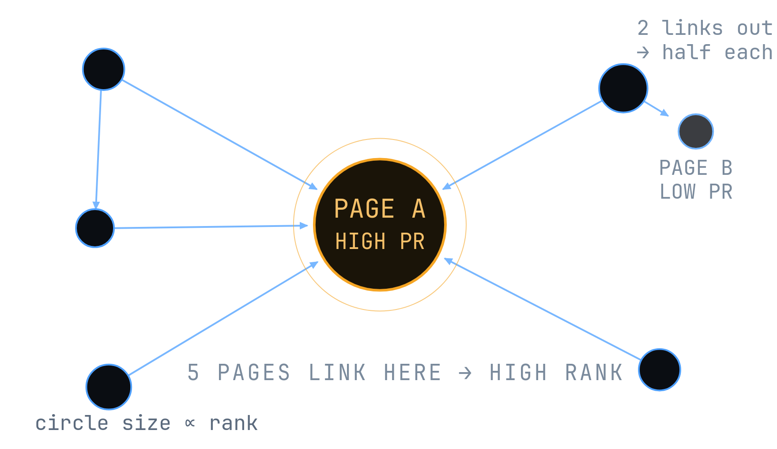
MODULE I · Q1 — OBJECTIVE & MOTIVATION
So… what makes a web page important?
HOW TO READ THIS PICTURE
01
Every circle is a web page. Every arrow is a link from one page to another.
02
Importance flows along the arrows , in the direction they point.
03
A page with two links out gives each one half of its own rank — a vote is not free.
04
Page A is large because five pages point at it. Page B has one link, from a page that is itself small.
WHAT
Compute the rank of every node in a directed graph.
WHY
Real graphs are huge and the ranks are recomputed many times — so parallelise it with OpenMP.
WHERE
Search ranking, citation analysis, any link structure.
PageRank turns link structure into a numerical measure of importance.
Notes:
Teach the diagram before the text. Say: every circle here is a web page, every arrow is a link, and the size of the circle is proportional to that page's computed rank — this is not decoration, it's the actual output of the algorithm we're about to define. Ask the audience which circle looks most important; they'll point at the big one — that's the whole intuition in one glance. Explain why it's big: five separate pages link to it. Then point at the small page with two outgoing arrows and say it doesn't get to vote twice at full strength — it splits its own rank in half, sending half down each link; that single rule is what makes link spam not work. Contrast with the small page (Page B), which has one incoming link from a page that is itself unimportant, so it stays small. Only after all of that, read the formal objective: compute the rank of every node in a directed graph, then study how to compute it in parallel with OpenMP. If asked where the numbers start: every page begins at 1/N and the arrows redistribute that rank repeatedly until it stops changing — that's the next slide.

Slide 5
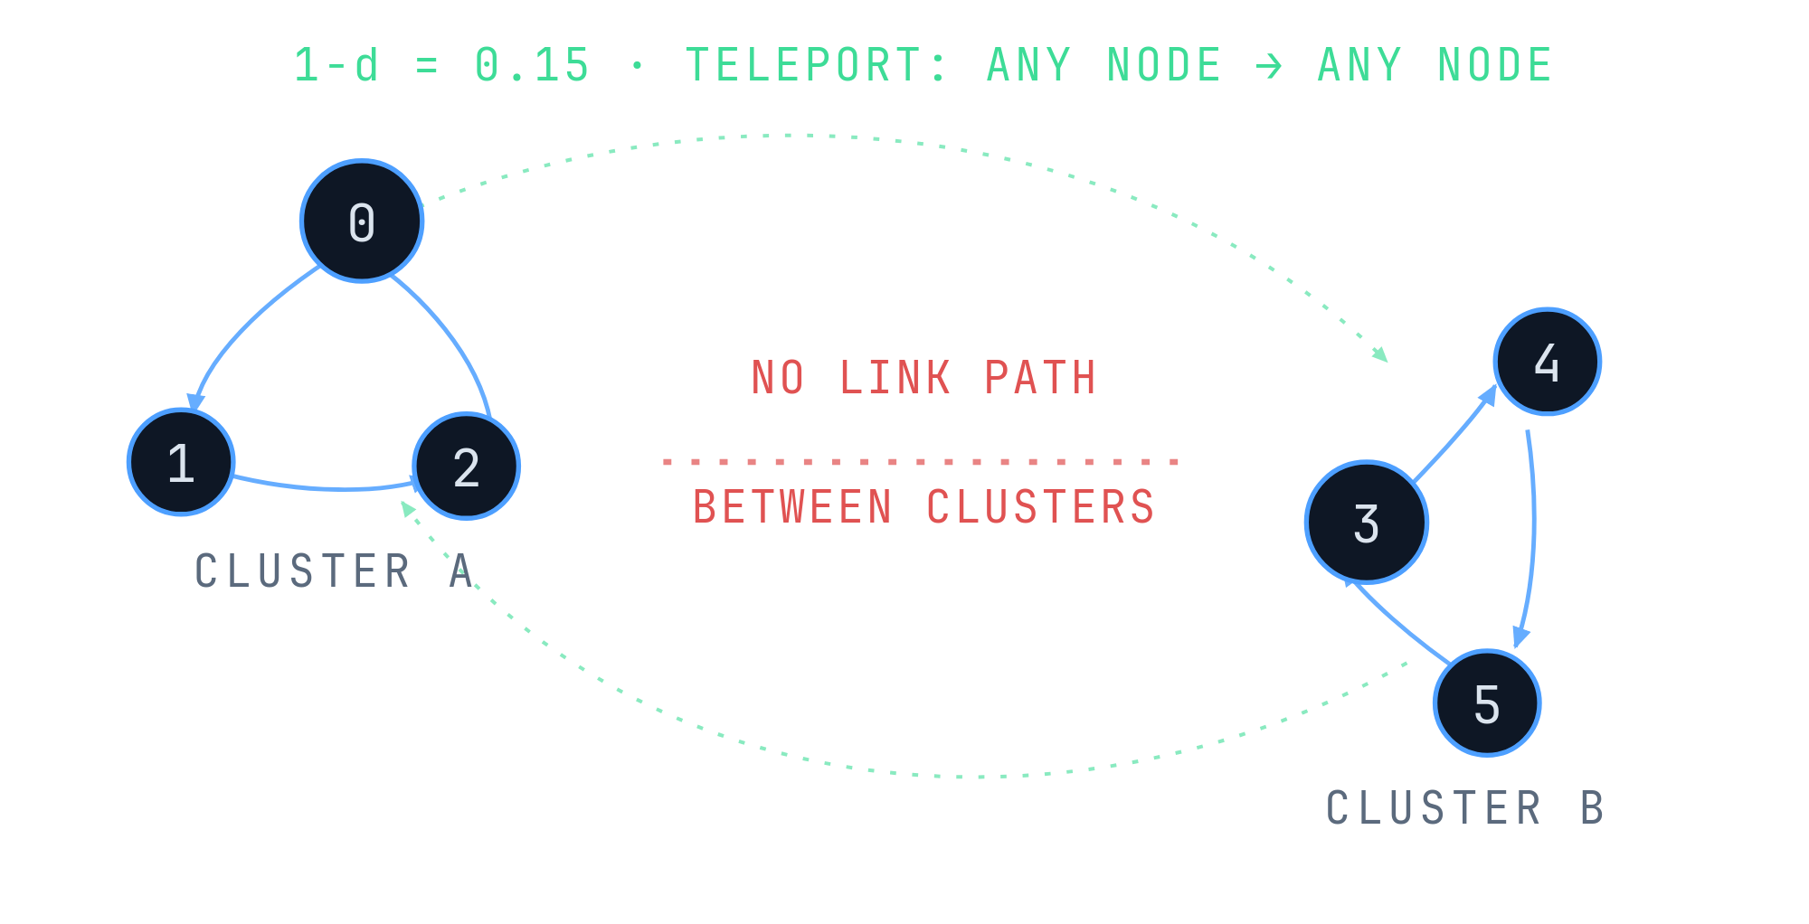
WHY THE DAMPING FACTOR EXISTS
Without teleportation, disconnected pages are unreachable
01
A pure link-following walk (d=1) can get permanently trapped inside whichever component it starts in.
02
A disconnected graph's transition matrix is reducible — it has no single, well-defined stationary distribution to converge to.
03
The fix: with probability 1−d, ignore links entirely and jump to a uniformly random node anywhere in the graph.
04
That always-on term, (1−d)/N , is added identically to every node — it stitches disconnected clusters into one chain and guarantees convergence.
Damping isn't only for dangling nodes — it's what makes PageRank well-defined on any graph, connected or not.
Notes:
This slide exists to answer a question a sharp examiner will ask: why 0.85, why not just follow links forever? Explain with the two clusters: if the surfer only ever follows real links (d=1), and the graph has two pieces with no edges between them, a surfer starting in cluster A can never reach cluster B — the walk is trapped in whichever component it started in. Mathematically, the transition matrix of a disconnected graph is reducible, and a reducible Markov chain does not have one single stationary distribution — it has one per component, so plain link-following iteration has no single well-defined PageRank vector to converge to. The fix is teleportation: with probability 1-d, the surfer ignores every link and jumps to a uniformly random node anywhere in the whole graph, cluster boundary or not. That single always-on term, (1-d)/N, added identically to every node regardless of the graph's structure, is exactly what stitches the components back together into one chain. It makes the chain irreducible and aperiodic, which by the Perron-Frobenius / fundamental Markov chain theorem guarantees a unique stationary distribution exists and the power-iteration recurrence converges to it — for any graph, connected or not, with or without dangling nodes. Close by saying d=0.85 is Google's chosen balance: high enough that real link structure still dominates the ranking, low enough that the 15% teleport share is always strong enough to guarantee convergence.

Slide 6
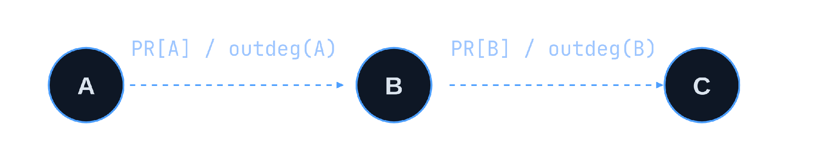
MODULE I · Q2 — SERIAL ALGORITHM
The core idea: rank flows through links
0.85
damping factor d
Initialize PR[i] = 1/N
KEY PARAMETERS
repeat
d
Damping factor (0.85)
dangling = sum PR[j], for outdeg(j) = 0
N
for each node i:
Number of nodes
newPR[i] = (1-d)/N + d*dangling/N
outdeg(j)
Out-degree of node j
for each j -> i:
ε (eps)
Convergence threshold
newPR[i] += d*PR[j]/outdeg(j)
error = sum |newPR[i] - PR[i]|
Dangling nodes (outdeg = 0) redistribute their rank equally across all N nodes — otherwise rank "leaks" out of the system.
PR = newPR
until error < eps
Notes:
Build this up in layers, don't start with the pseudocode. First the three-node picture: Page A sends PR[A]/outdeg(A) down each of its outgoing edges — say aloud that a page divides its rank evenly among however many links it has. Second, introduce d = 0.85 as the damping factor and explain in one sentence what it means: 85% of the time follow a link, 15% of the time jump randomly (tying back to the intuition slide). Only then reveal the pseudocode line by line: initialize every PR[i] to 1/N; each iteration first computes the dangling sum — the total rank held by nodes with no outgoing links, because that rank has nowhere to go and must be redistributed evenly across all N nodes or it silently leaks out of the system; then for every node, newPR[i] is the base term (1-d)/N plus the damping share of the dangling sum plus the damping-weighted sum of PR[j]/outdeg(j) for every predecessor j; then compute the error as the sum of absolute differences between new and old PR, swap the buffers, and repeat until error is below epsilon. Emphasize the dangling-node handling — it's the one part of the recurrence that isn't obvious from the naive 'PageRank is a random walk' description.

Slide 7
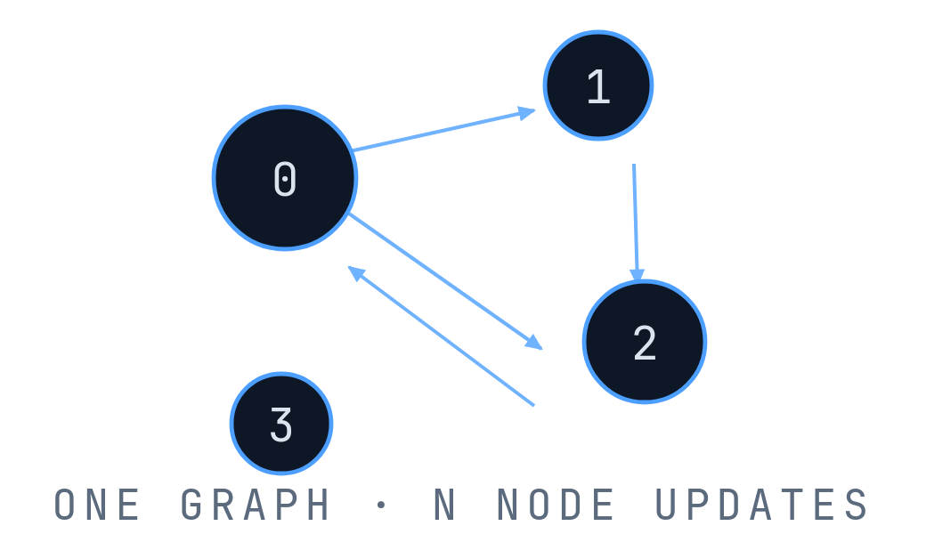
MODULE II · FOSTER'S DESIGN METHODOLOGY
Now split the work
THREAD 0
nodes { 0, 1 }
→
THREAD 1
nodes { 2, 3 }
static schedule · shared PR[] and graph · reductions for dangling & error
P
Partitioning
C
Communication
A
Agglomeration
M
Mapping
Data decomposition
Divide nodes among threads
Same computation on each chunk
Shared PR[] and graph
Global: dangling sum & error
Use reduction for global values
Group nodes into chunks
Reduce parallelization overhead
Map chunks to OpenMP threads
Static scheduling
Fixed node ranges per thread
Notes:
Frame PCAM as an engineering process the algorithm suggests on its own, not a list of four textbook words to memorize. Start from the observation already established two slides back: every node's newPR[i] only reads old PR values and writes to its own slot, so nothing stops us from doing several nodes at once. Partitioning: divide the N node-update computations among threads, e.g. thread 0 gets nodes {0,1}, thread 1 gets {2,3}. Communication: threads all read the same shared graph and PR array, and the two values every thread needs to contribute to — the dangling sum and the error — are computed as parallel reductions rather than by explicit messages. Agglomeration: instead of scheduling one node per task, group multiple nodes into a contiguous chunk per thread to amortize the overhead of spinning up parallel work. Mapping: OpenMP's static schedule assigns each thread a fixed, contiguous block of node indices for the whole run — say why static and not dynamic: the work per node is uniform (same formula, degree-proportional cost), so there's no load-imbalance to correct for.

Slide 8
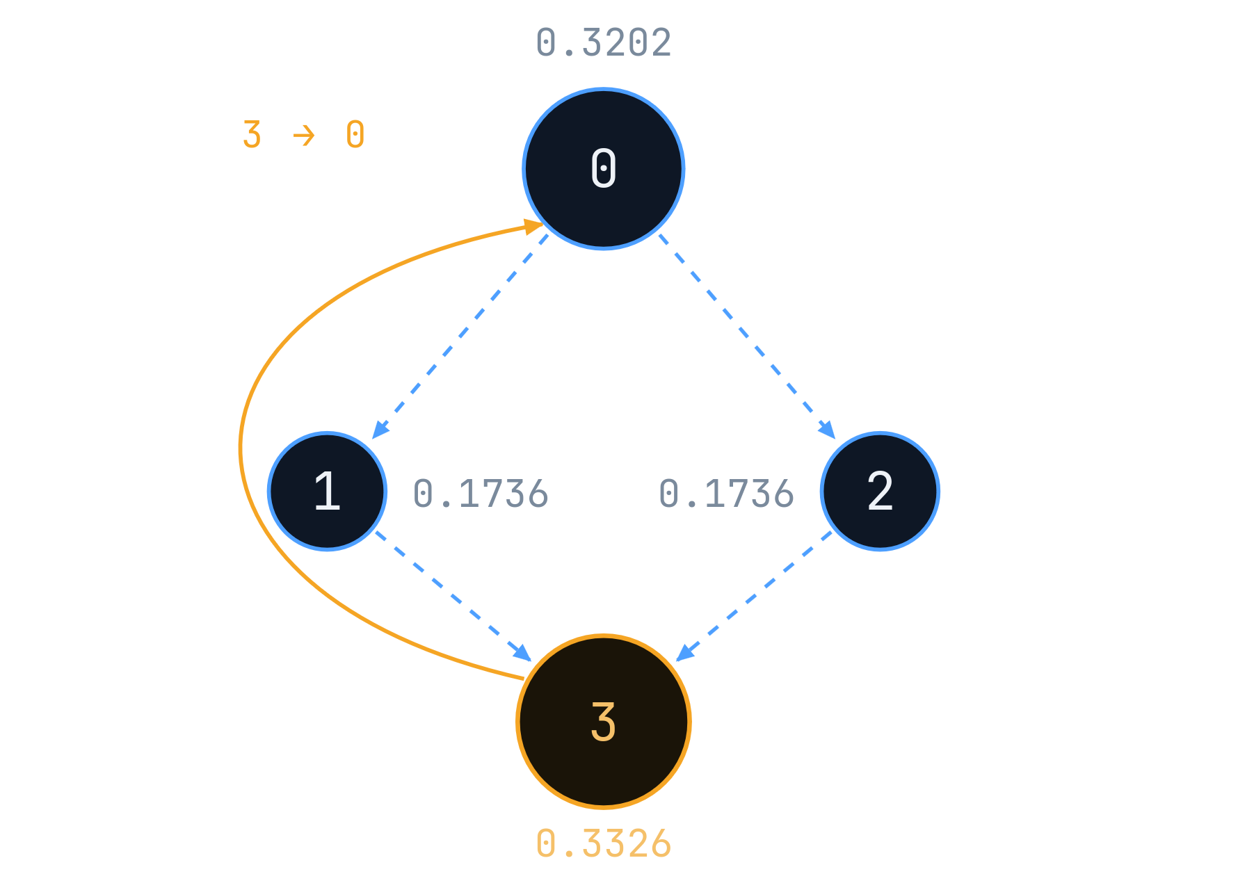
SOLUTION DEMONSTRATION
MODULE I · Q3 — WORKED EXAMPLE 1
N = 4 · d = 0.85 · no dangling node
Example 1 — watch the rank move
INITIAL STATE
PR = (0.25, 0.25, 0.25, 0.25)
ITERATION 01
NODE
UPDATE
VALUE
PR[0]
0.0375 + 0.85×(PR[3]/1)
0.2500
PR[1]
0.0375 + 0.85×(PR[0]/2)
0.1438
PR[2]
0.0375 + 0.85×(PR[0]/2)
0.1438
PR[3]
0.0375 + 0.85×(PR[1]/1 + PR[2]/1)
0.4625
error after iteration 1 = 0.4250
ITERATION 02
PR = (0.4306, 0.1438, 0.1438, 0.2819) · error = 0.3613
CONVERGED
81
iterations
PR[0]
PR[1]
PR[2]
PR[3]
0.3202
0.1736
0.1736
0.3326
outdeg: 0:2 · 1:1 · 2:1 · 3:1 — node area ∝ converged rank
Node 3 receives the full rank of both 1 and 2, then hands it back to the hub — so the loop settles with 0 and 3 sharing most of the mass.
Notes:
This is the graph with no dangling node: edges 0→1, 0→2, 1→3, 2→3, 3→0. Start every PR at 0.25. Walk iteration 1 on the board using the exact formula from the serial-algorithm slide: PR[0] gets the full rank of node 3 (its only predecessor) scaled by d, plus the base term, landing at 0.25; PR[1] and PR[2] each get half of node 0's rank, landing at 0.1438 each; PR[3] is the interesting one — it receives the full rank of both node 1 and node 2, since both point only to node 3, so it jumps to 0.4625, comfortably the largest value after just one step. Say explicitly: 'notice node 3 already overtakes everyone else in the very first iteration, before the process has even had time to settle — that's because it's the sole recipient of two separate incoming votes.' Then skip to the converged state after 81 iterations: PR = (0.3202, 0.1736, 0.1736, 0.3326). Explain the final shape: nodes 0 and 3 form a two-node cycle that keeps trading rank back and forth, so they end up with most of the mass, while 1 and 2 are pass-through nodes that receive from 0 and immediately hand everything to 3, keeping little for themselves.

Slide 9
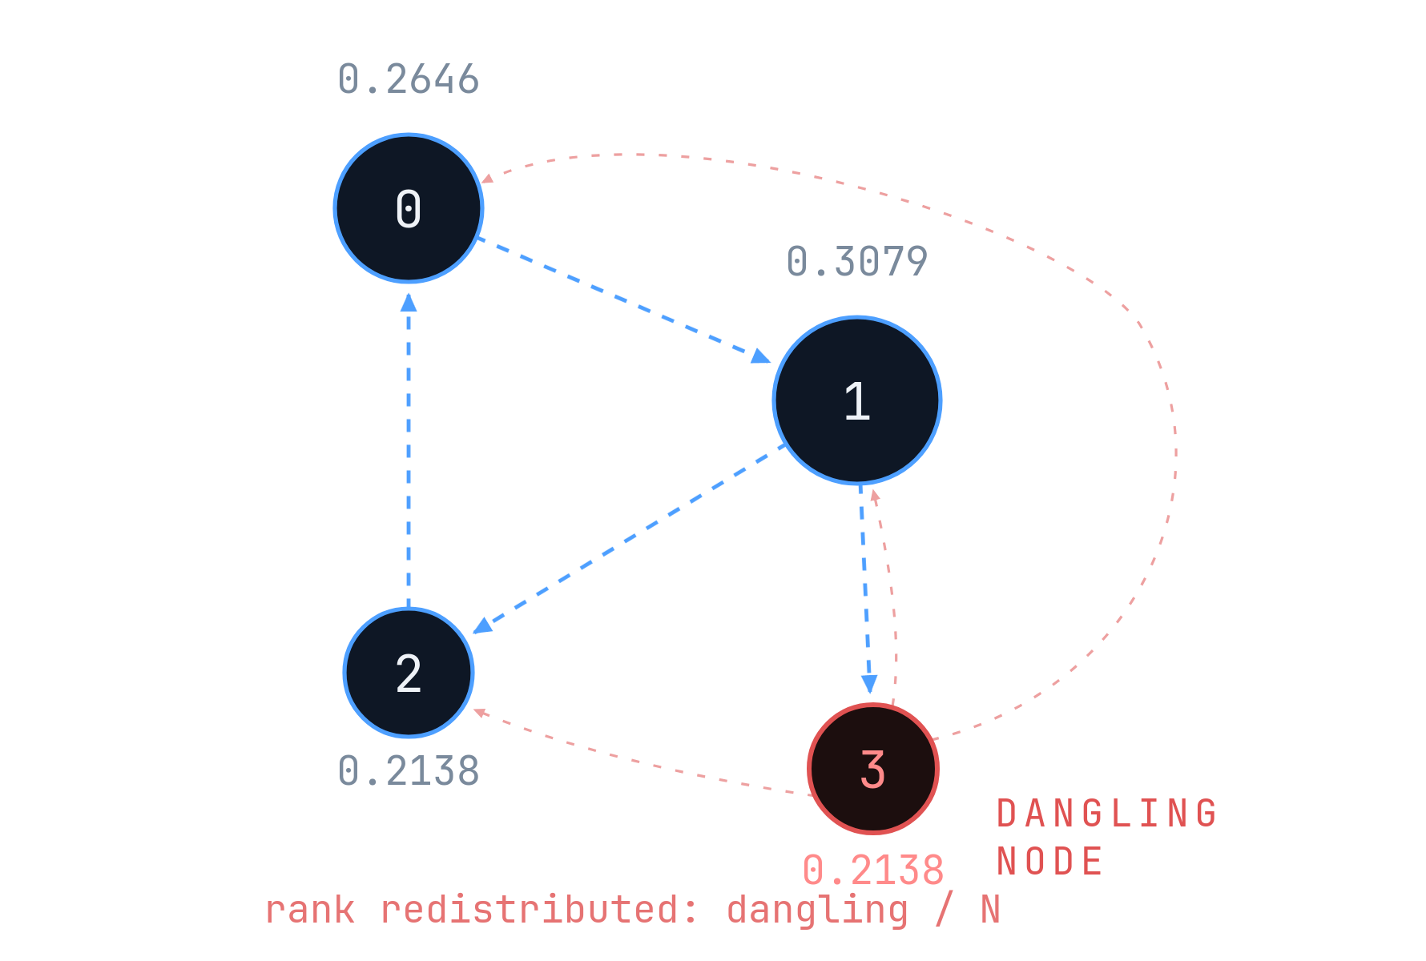
SOLUTION DEMONSTRATION
MODULE I · Q3 — WORKED EXAMPLE 2
N = 4 · d = 0.85 · outdeg(3) = 0
Example 2 — what happens when a page has nowhere to go?
ITERATION 01
base = 0.0375 · dangling term = 0.053125
NODE
UPDATE
VALUE
PR[0]
base + 0.85×PR[2] + dngl
0.3031
PR[1]
base + 0.85×PR[0] + dngl
0.3031
PR[2]
base + 0.85×(PR[1]/2) + dngl
0.1969
PR[3]
base + 0.85×(PR[1]/2) + dngl
0.1969
error after iteration 1 = 0.2125
ITERATION 02
PR = (0.2467, 0.3370, 0.2082, 0.2082) · error = 0.1129
CONVERGED
32
iterations
PR[0]
PR[1]
PR[2]
PR[3]
0.2646
0.3079
0.2138
0.2138
outdeg: 0:1 · 1:2 · 2:1 · 3:0
Without redistribution rank leaks
With redistribution rank conserved
Notes:
This is the graph with a dangling node: edges 0→1, 1→2, 1→3, 2→0, and node 3 has no outgoing edges at all (outdeg(3) = 0). Point at node 3 and say plainly: this page has nowhere to send its rank — if we did nothing about that, its share of the total rank would simply vanish from the system every iteration, and the total wouldn't stay conserved at 1. Show the fix: sum up all dangling nodes' rank (here just node 3's) and redistribute that dangling total evenly across all N nodes, adding dangling/N to every node's update, exactly as in the general recurrence. Walk iteration 1 numerically: base term 0.0375 plus dangling contribution 0.053125 applied everywhere, then each node also picks up its damped share from its real predecessors — giving PR[0]=0.3031, PR[1]=0.3031, PR[2]=0.1969, PR[3]=0.1969. State the converged result after 32 iterations: PR = (0.2646, 0.3079, 0.2138, 0.2138). Close with the two-line contrast that's the real takeaway of this slide: without redistribution, rank leaks out of the system and the values wouldn't sum to 1; with redistribution, total rank is conserved every single iteration.

Slide 10
MODULE I · Q4–Q5 — SERIAL IMPLEMENTATION
Serial PageRank: input size vs. runtime
Input: node count N and generated edge count E. Hold graph-generation rule and ε constant.
PER ITERATION
TOTAL
SPACE
Input density: about 6 edges/node (existing pattern)
O(N + E)
O(I · (N + E))
O(N + E)
OBSERVATION TABLE · N is the experiment input
Input nodes N
Generated edges E
Iterations
Serial time (s)
Result status
1,000
5,994
13
0.000120
Measured
10,000
59,995
13
0.001672
Measured
100,000
599,992
13
0.020366
Measured
1,000,000
≈ 6,000,000
Measure
Measure
Run this input
10,000,000
≈ 60,000,000
Measure
Measure
Large input; check RAM
How to run: change N as an input parameter; generate/build the graph, then time the serial algorithm.
Record compiler flags, ε, iteration count, CPU, and median of repeated runs. Do not treat proposed rows as measured.
Notes:
Establish the cost model before showing any numbers. One iteration touches every node once (for the dangling sum and error) and every edge once (for the neighbor sum), so one iteration is O(N+E); running I iterations multiplies that by I, giving O(I·(N+E)) overall — write both formulas large, they're the point of the slide. Then walk the measured table: at N=1,000 (E=5,994) the serial run took 0.000120s; at N=10,000 (E=59,995) it took 0.001672s — roughly a 14x increase for a 10x graph, consistent with linear scaling in N+E; at N=100,000 (E=599,992) it took 0.020366s — another ~12x increase for another 10x graph. Explicitly call out that the iteration count stayed fixed at 13 across all three sizes — this is important because it means the runtime growth you're seeing is purely the O(N+E) per-iteration cost scaling up, not the algorithm needing more iterations to converge on a bigger graph. Close with: more nodes and more edges means strictly more work per iteration, but not more iterations.

Slide 11
MODULE II · Q6 — IDENTIFYING THE PARALLELIZABLE BLOCK
The good news: every node can be updated independently
PageRank iteration
SHARED
compute newPR[i], i = 0..N-1
PR[], graph / in-link adjacency (read-only during the loop).
↓
THREAD 0
newPR[0]
newPR[1]
…
PRIVATE
Loop variable i, local sum accumulator.
THREAD 1
newPR[2]
newPR[3]
newPR[N-1]
REDUCTION
BARRIER
Dangling sum, error norm.
↓
next iteration
SYNCHRONIZATION
Barrier required before the next iteration begins.
Node updates within one iteration are parallel, but iterations themselves remain sequential.
Notes:
This slide names exactly which piece of the algorithm gets parallelized and why. Point at the array of newPR[i] computations for one iteration and say: computing newPR[i] only reads the old PR array and only writes to slot i — no node's update touches any other node's output — so all N of these computations are mutually independent within a single iteration, and can run on different threads at the same time. Show the two-thread split (thread 0 handles nodes {0,1}, thread 1 handles {2,3}) and say each thread just runs the same per-node formula on its own subset. Then point at the BARRIER and say the crucial caveat clearly, twice if needed: the next iteration's PR values depend on this iteration's newPR values being fully finished for every node, so we cannot start iteration 2 until every thread has completed iteration 1 — that's why there's a synchronization barrier between iterations. Land on the one sentence to memorize: node updates within one iteration are parallel, but the iterations themselves remain strictly sequential.

Slide 12
MODULE II · Q7 – Q8 — OPENMP IMPLEMENTATION
Turning the recurrence into OpenMP
Initialize PR[i] = 1/N
01
Calculate dangling sum
repeat
02
Parallelize node updates
#pragma omp parallel for reduction(+:dangling)
03
Synchronize
dangling = sum PR[j], outdeg(j)=0
04
Calculate error
#pragma omp parallel for
for each i: compute newPR[i]
05
Swap PR / newPR
barrier
06
Repeat until converged
#pragma omp parallel for reduction(+:error)
error = sum |newPR[i]-PR[i]|
STATIC PARTITION · 2 THREADS · NODES 0–3
PR = newPR
until error < eps
T0
T1
{ 0, 1 }
{ 2, 3 }
BARRIER
Parallel result = serial result
PR = (0.2646, 0.3079, 0.2138, 0.2138)
32 iterations — identical to serial
Notes:
Map the six numbered steps directly onto the code shown: (1) calculate the dangling sum with a #pragma omp parallel for reduction(+:dangling) — explain that 'reduction' means each thread keeps its own private running total and OpenMP combines them safely at the end, avoiding a race condition on a single shared variable; (2) parallelize the node-update loop with a plain #pragma omp parallel for, since each iteration of that loop writes to a distinct, private newPR[i] slot — no reduction needed there; (3) an implicit barrier after that parallel region, which OpenMP inserts automatically at the end of every parallel for; (4) calculate the error, again with a sum reduction; (5) swap the PR and newPR pointers — done serially, it's O(1) and not worth parallelizing; (6) repeat until the error drops below epsilon. Show the concrete 2-thread mapping (T0 → nodes {0,1}, T1 → nodes {2,3}) on the dangling-node graph from Example 2, and state the single most important experimental result on this slide: running that graph in parallel produced the identical converged values, PR = (0.2646, 0.3079, 0.2138, 0.2138), after the identical 32 iterations — parallel correctness was verified against the serial baseline, not just assumed.

Slide 13
PageRank OpenMP: Synchronization Strategy Benchmark
N = 10,000 • 4 threads • 55,000 edges • tolerance = 10⁻⁸ • 8 iterations
No.
Dangling Sum
Error Sum
Runtime (s)
Iterations
WHAT THE RESULTS SAY
1
Reduction
Reduction
0.00165437
8
FASTEST OBSERVED
2
Critical
Critical
0.02187610
8
Reduction + Reduction · 0.00165437 s
3
Atomic
Atomic
0.01539558
8
4
Reduction
Critical
0.01919751
8
SLOWEST OBSERVED
Critical + Critical · 0.02187610 s
5
Reduction
Atomic
0.01346428
8
6
Critical
Reduction
0.00179802
8
INTERPRETATION
Reduction + Reduction is the recommended baseline: it avoids per-update locking. The fastest single run is not proof of a generally faster method.
7
Critical
Atomic
0.01527215
8
8
Atomic
Reduction
0.00231659
8
9
Atomic
Critical
0.01645321
8
Important: this graph has no dangling nodes, so the dangling-sum loop performs no shared updates. Repeat runs on a graph with dangling nodes for a fairer comparison.
PRACTICAL TAKEAWAY
REDUCTION + REDUCTION
ATOMIC + REDUCTION
CRITICAL + CRITICAL
Best default to benchmark
Fastest in this run
Slowest in this run
Low synchronization overhead
Validate with repeated runs
Frequent serialized updates
Use identical inputs and compiler flags; report median runtime across 7–10 runs. Do not alter measured values to fit an expected result.

Slide 14
PageRank: Serial vs Parallel Performance
Measured results across six graph sizes
Input nodes (N) | Threads (P) | Serial time (s) | Parallel time (s) | Speedup | Efficiency
5 | 2 | 0.00000019 | 0.00025754 | 0.0007× | 0.04%
1,000 | 2 | 0.00010956 | 0.00020852 | 0.53× | 26.27%
10,000 | 4 | 0.00054458 | 0.00061081 | 0.89× | 22.28%
100,000 | 8 | 0.00483282 | 0.00204145 | 2.37× | 29.60%
1,000,000 | 16 | 0.04661068 | 0.01645861 | 2.83× | 17.70%
10,000,000 | 16 | 0.49055496 | 0.18424764 | 2.66× | 16.64%
SERIAL ./pagerank_serial N • PARALLEL ./pagerank_openmp N P
Speedup = Serial time ÷ Parallel time | Efficiency = Speedup ÷ Threads × 100%
Notes:
This slide reports the actual measured OpenMP benchmark. Walk the numbers plainly: 1 thread is the 0.044974s baseline; 2 threads drops to 0.034123s, giving the best speedup measured, 1.318x; but 4 threads rises back to 0.041428s (1.086x), 8 threads to 0.083010s (0.542x, slower than serial), and 16 threads to 0.163225s (0.276x, over 3x slower than serial). Explain why immediately: the parallel node-update phase is followed by an O(N) merge step that runs inside an OpenMP critical section - only one thread can execute it at a time, so every other thread stalls waiting its turn. Adding threads adds more waiters, not more throughput, and the synchronization and contention cost grows faster than the work saved. The headline point: more threads does not mean more speedup once a serialized merge dominates. If asked how to fix it: replace the critical-section merge with a parallel reduction so the merge itself is parallelized instead of serialized.

Slide 15
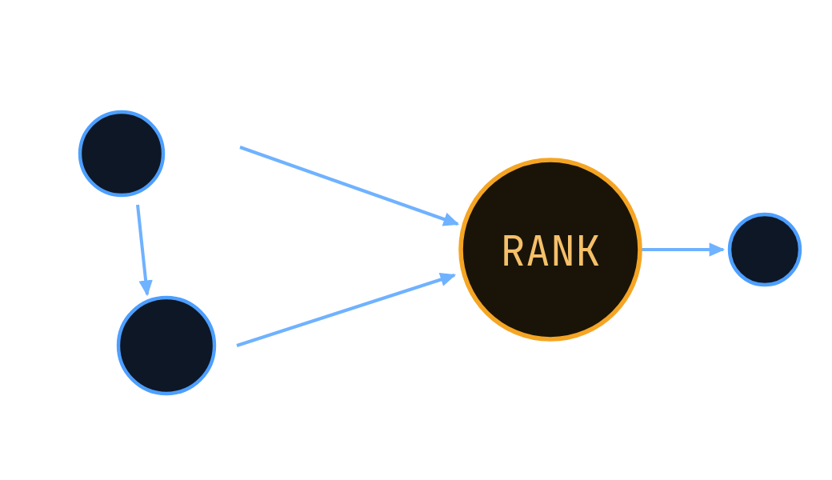
CONCLUSION
PageRank: from links → rank → parallel work
GRAPH → RECURRENCE → ITERATIONS → CONVERGENCE → OPENMP → PERFORMANCE
Correctness first
PCAM gave structure
Scaling is data-dependent
Dangling nodes matter
Serial and OpenMP results match exactly on both test graphs.
Partitioning + shared data + reductions + static mapping.
Redistribution keeps total rank conserved across iterations.
Runtime follows O(I·(N+E)); observed speedup is capped by available cores, not the algorithm.
Notes:
Walk the pipeline left to right exactly once — graph, recurrence, iterations, convergence, OpenMP, performance — as a recap of the entire talk's structure, using the same words as the roadmap slide so it feels like the story has closed a loop. Then land on the four takeaways in order and expand each briefly: correctness first — the serial and OpenMP implementations were checked against each other and produced identical numbers on both worked examples, which matters more than any speed number; PCAM gave structure — partitioning nodes, sharing the graph and PR array, using reductions for the two shared scalars, and static mapping to threads wasn't an afterthought, it was a deliberate design process; scaling is data-dependent — runtime follows O(I·(N+E)) predictably, and the measured speedup is capped by the hardware actually available, not by any weakness in the algorithm or the parallel design; dangling nodes matter — without explicit redistribution of their rank, the total rank in the system would not stay conserved, which would quietly break the mathematical guarantees of the whole method. Close with 'thank you' and open the floor.

Slide 16
GRAPH MACHINE LEARNING · REAL-WORLD RELEVANCE
PageRank + Graph ML in the modern world
PageRank measures network importance; Graph ML uses that signal to make better predictions.
01
HOW THEY WORK TOGETHER
02
SOCIAL NETWORKS
PageRank scores identify influential nodes. Graph ML combines these scores with node features and connections to learn patterns.
Find influential accounts, suggest relevant people or communities, and improve content recommendations using relationship patterns.
03
WEB SEARCH & DISCOVERY
04
FRAUD & SPAM DETECTION
Link importance can help rank useful pages and entities, alongside content quality, freshness, and many other signals.
Graph patterns can expose suspicious account clusters, coordinated activity, and links to known risky entities.
05
RECOMMENDATIONS
06
WHY IT MATTERS TODAY
Use graph relationships and importance scores to support product, video, paper, or friend recommendations.
Digital services are interconnected. Graph ML turns those connections into signals for ranking, discovery, risk analysis, and prediction.
KEY IDEA: PageRank provides an importance signal; Graph ML learns from that signal plus the wider graph.
PageRank is one useful feature—not a complete ranking or decision system on its own.

Slide 17
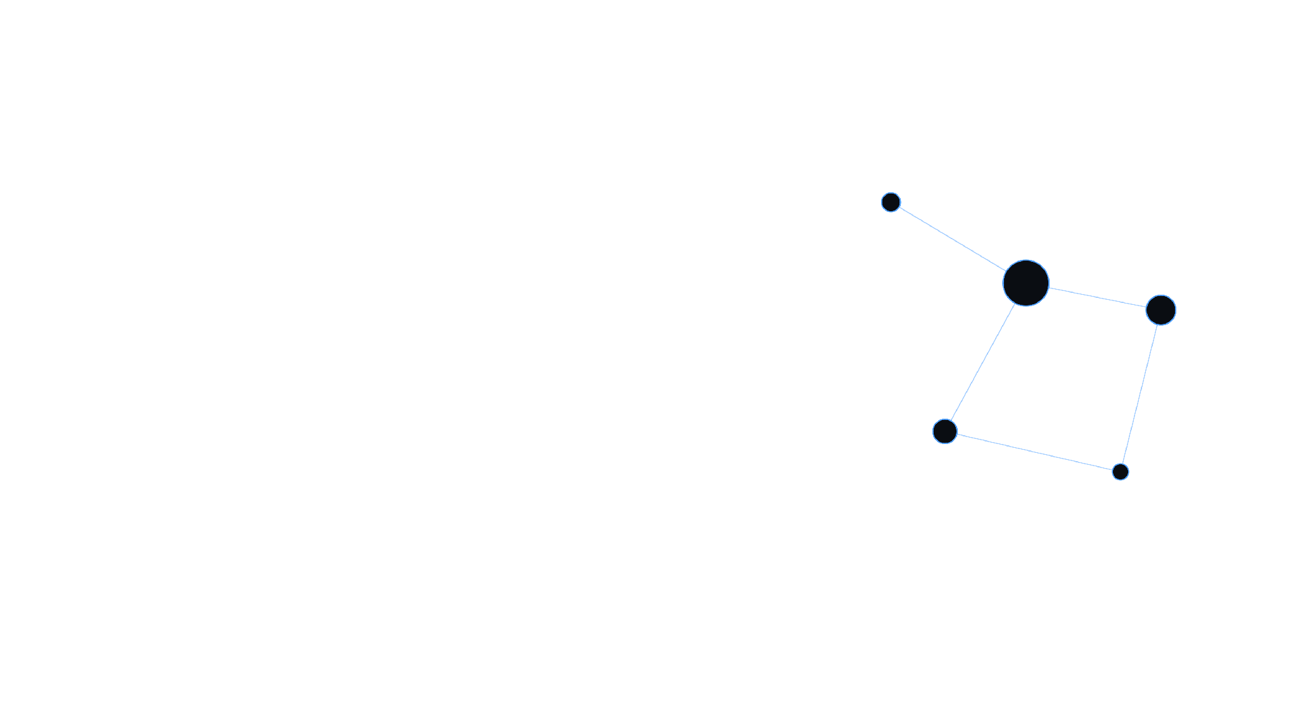
Thank you.
Notes:
Simply say thank you and invite questions. The likely questions, in rough order of probability, are: why is d specifically 0.85 (it's the empirically-chosen value from the original Google paper, balancing convergence speed against how much the random-jump term dominates); what happens if a graph has no dangling nodes at all (the dangling term is just always zero, the rest of the recurrence is unchanged); why does the parallel version need a barrier between iterations if the nodes are independent (because iteration k+1 needs iteration k's completed newPR values as its input — the independence is only within one iteration, not across iterations); and why didn't parallelism help here (repeat the one-logical-core explanation from the performance slide plainly, without hedging).

